Slide 1


Comparing the Loss of Honey Bee Colonies by Reason of Loss and by US Regions
Cristina Iacob

Slide 2
Bees Facts

Slide 3
Research Questions
For this analysis the goal is to identify:
Is there a difference between the loss of honey bee colonies by colony collapse disorder (CCD) and the loss due to dead-out phenomenon ?
Is there a significant difference between the loss of honey bee colonies by US agricultural regions ?
Notes:
test

Slide 4
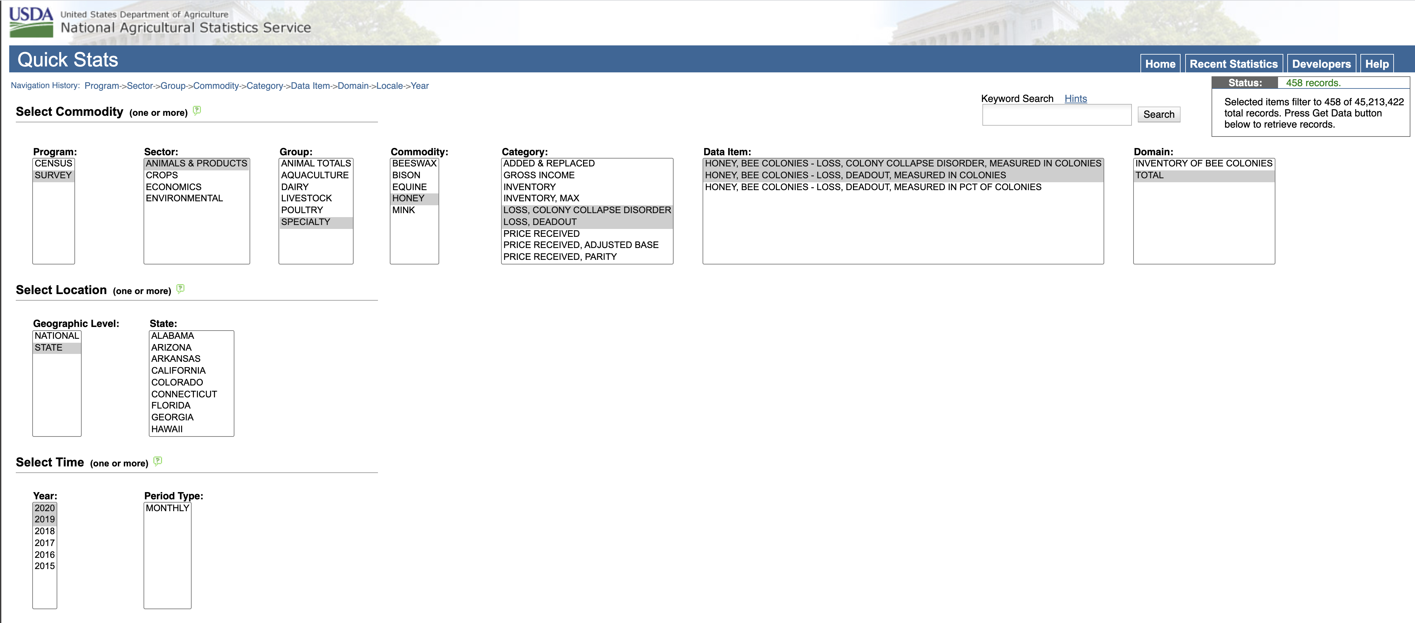
Exploring the Data
Data was sourced from: https://quickstats.nass.usda.gov/
with the following search criteria:
Data for State Abbreviations: https://www2.census.gov/geo/docs/reference/codes/files/national_county.txt
Data for Agricultural Regions: https://en.wikipedia.org/wiki/List_of_regions_of_the_United_States
Notes:
test

Slide 5
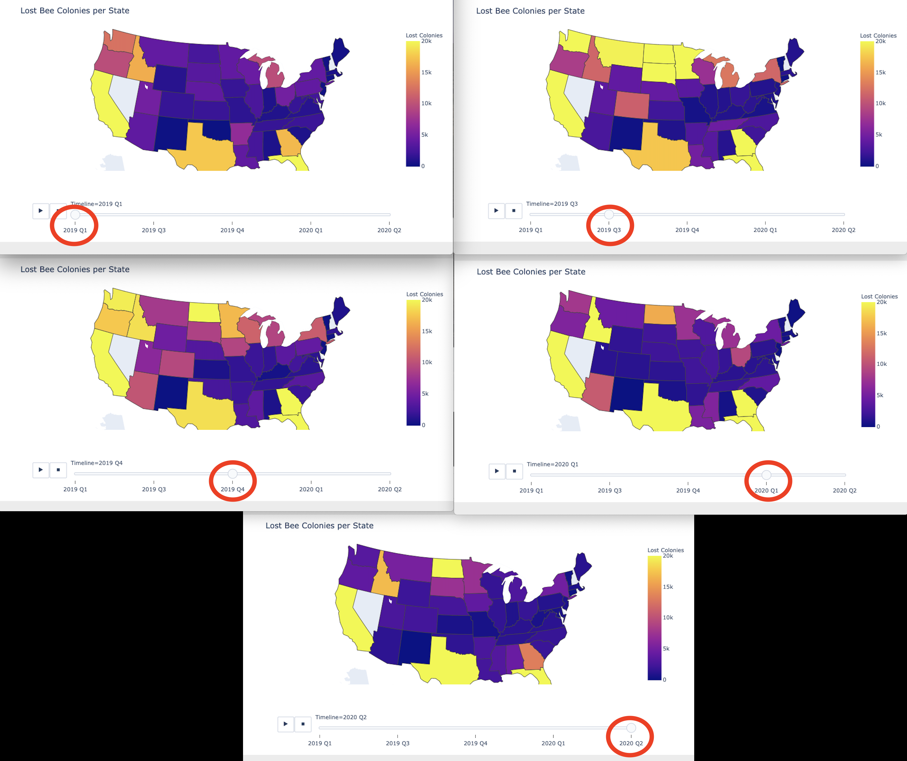
Timeline for Lost Colonies per State
Notes:
test

Slide 6
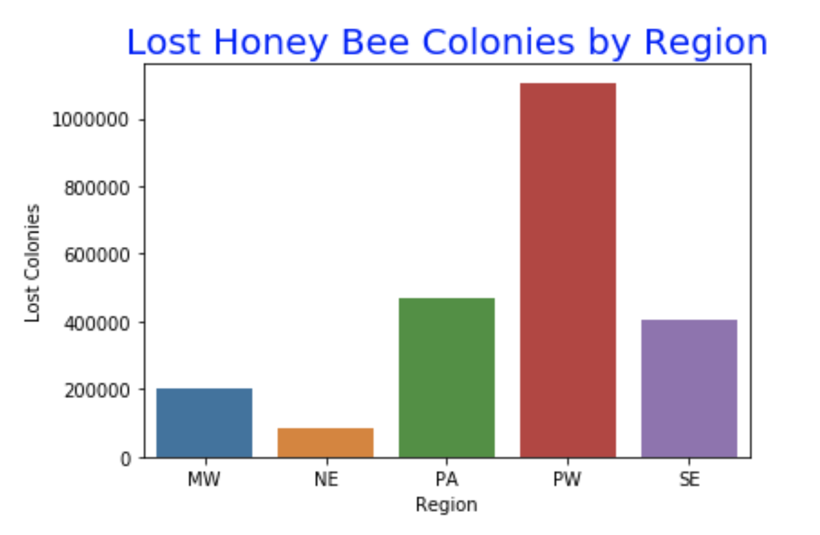
Total Honey Bee Colonies Lost per Region

Slide 7
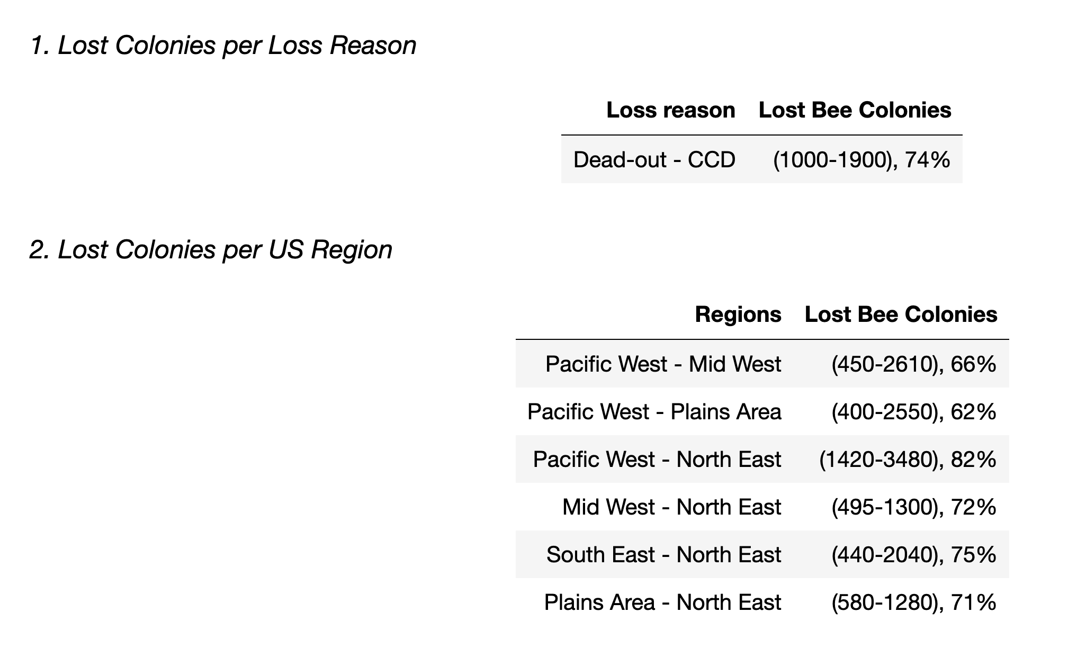
Results

Slide 8
Conclusions & Recommendations
What’s next?
Investigate if anything changes when combining the 2 groups: Region and Loss Reason
Is there a difference between the loss of honey bee colonies by colony collapse disorder (CCD) and the loss due to dead-out phenomenon ?
Is there a significant difference between the loss of honey bee colonies by US agricultural regions ?

Slide 9

Questions?

Slide 10

Thank you!

